Slide 1
Making a cross-platform mobile app: It’s easier than you think!
Fridays @ the Beaufort Digital Corridor • April 21, 2017
Brian Canada, PhD
Assistant Professor of Computational Science
University of South Carolina Beaufort
bcanada@uscb.edu

Slide 2
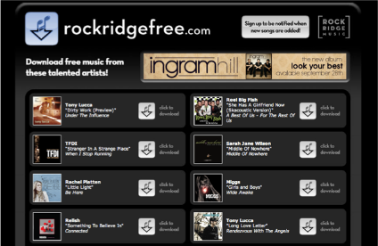
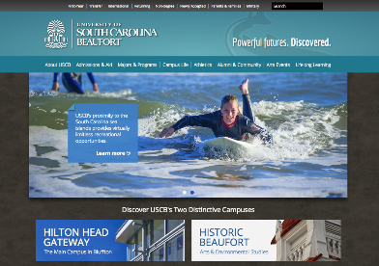
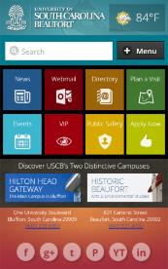
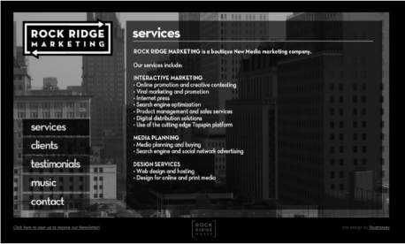
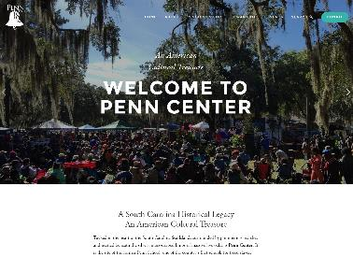
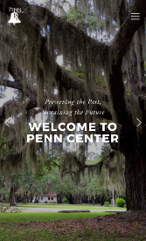
Selected examples of my web development work over the years… (Obligatory “credibility slide”)

Slide 3
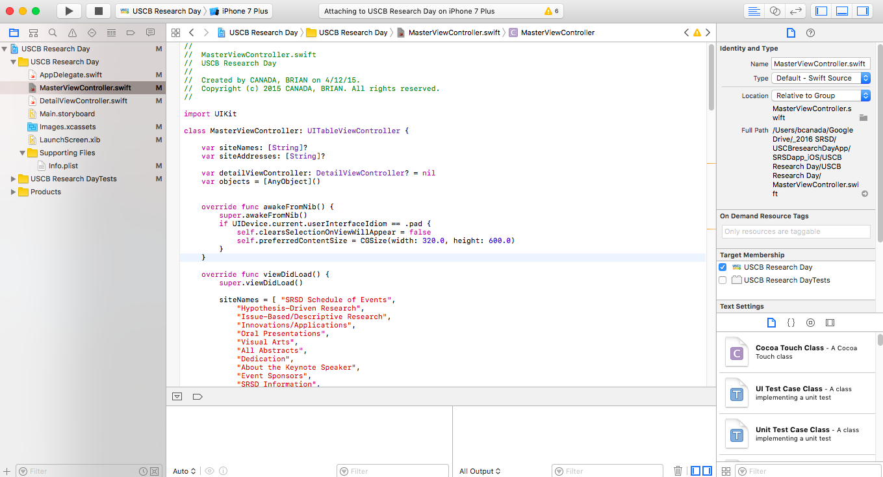
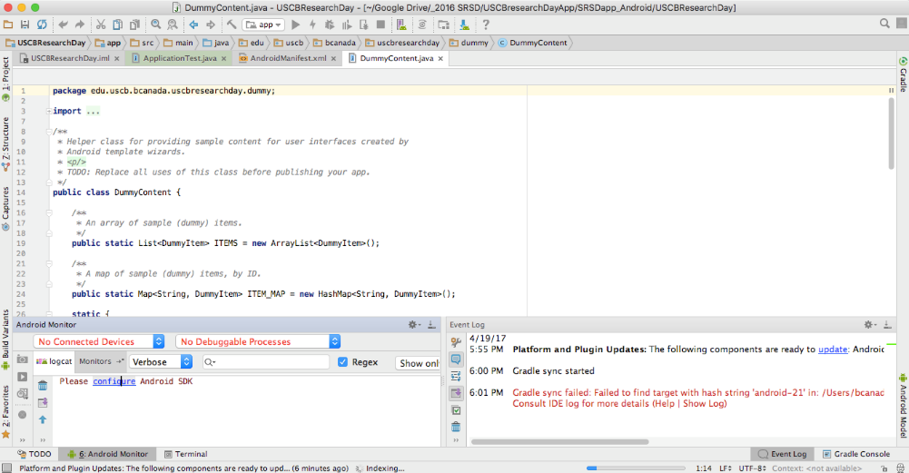
Developing native apps for multiple platforms historically has required writing and maintaining separate codebases (one for each mobile platform’s programming language and toolkit)
Native Android apps are coded using Java & XML
Native iOS apps are coded using either Swift or Objective-C (and requires a Mac)

Slide 4
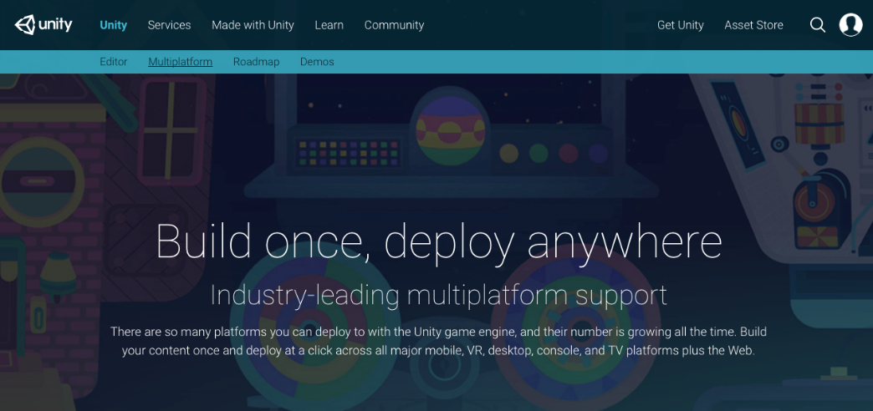
Many Game Engines export to mobile device platforms
GameSalad www.gamesalad.com
Unity www.unity3d.com

Slide 5
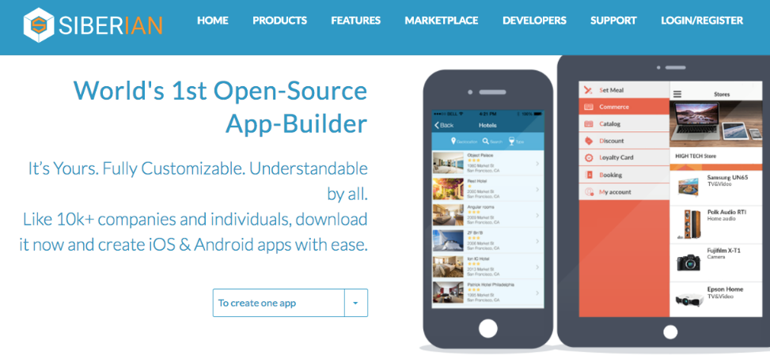
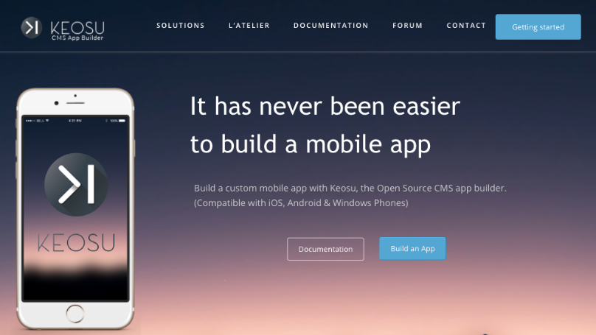
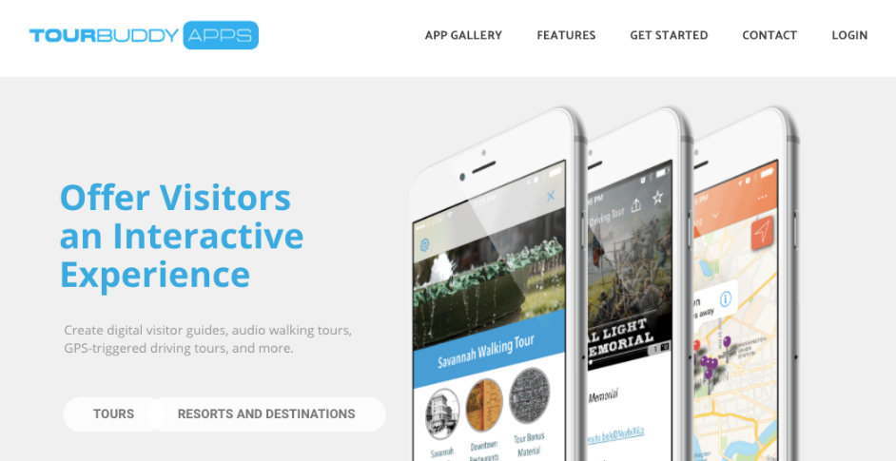
Some Content Management Systems (CMS) exist for mobile app development (think WordPress, but for apps)

Slide 6
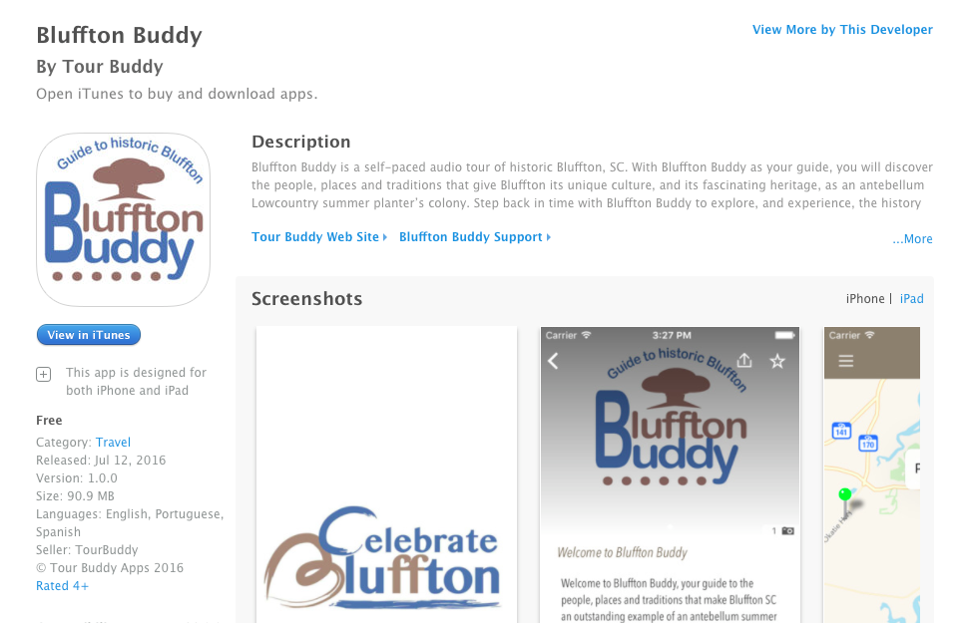
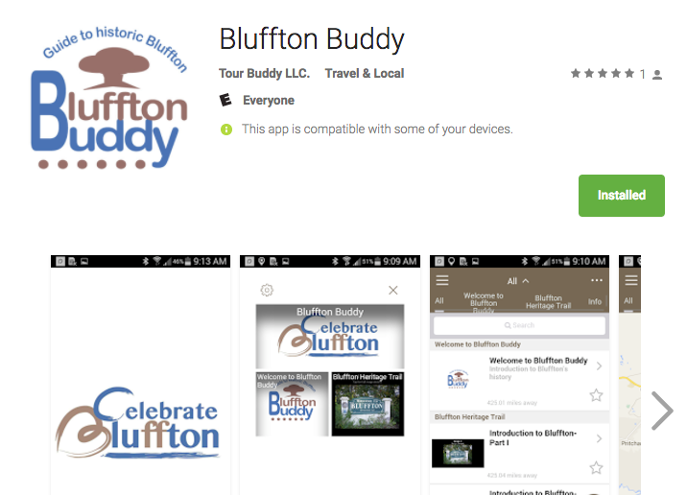
“Bluffton Buddy” Official Tourism App for the Town of Bluffton

Slide 7
Appery.io: a cloud-based, visual development environment for mobile apps https://appery.io/

Slide 8
So what do you do if you actually want to write your own application code…
…but you don’t have the time or energy to develop your app in multiple languages?

Slide 9
If you want to develop your own apps without a CMS or visual development environment, you can do a lot if you know (or are willing to learn) HTML, CSS, and a little JavaScript
HTML: for defining the structure and content of a web page
CSS: for defining a webpage’s style and presentation
JavaScript: for defining the behavior of a webpage

Slide 10
Adobe PhoneGap, a distribution of Apache Cordova http://phonegap.com/

Slide 11
PhoneGap enables developers to use a single HTML/CSS/JavaScript codebase to build apps that run on multiple mobile platforms

Slide 12
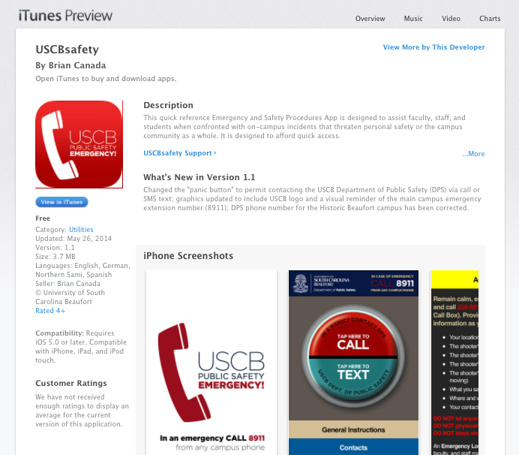
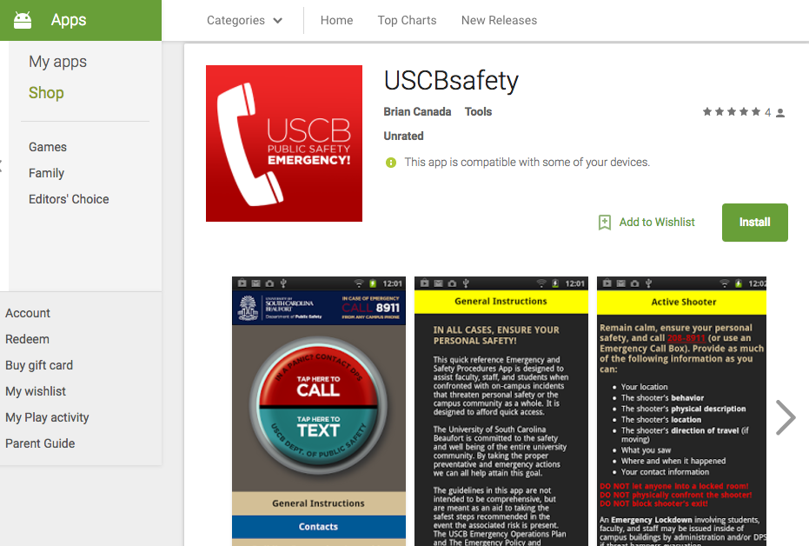
Case Study: USCBsafety, the official campus safety app for the University of South Carolina Beaufort

Slide 13
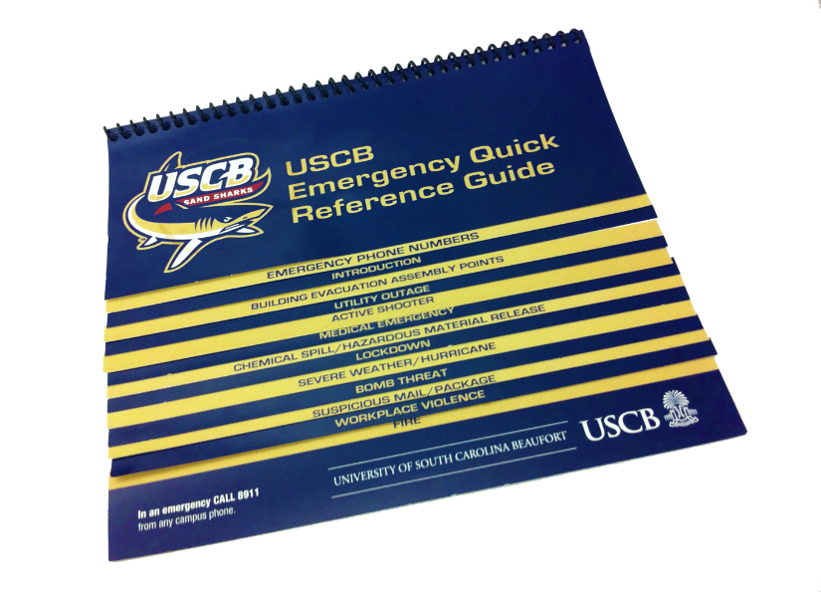
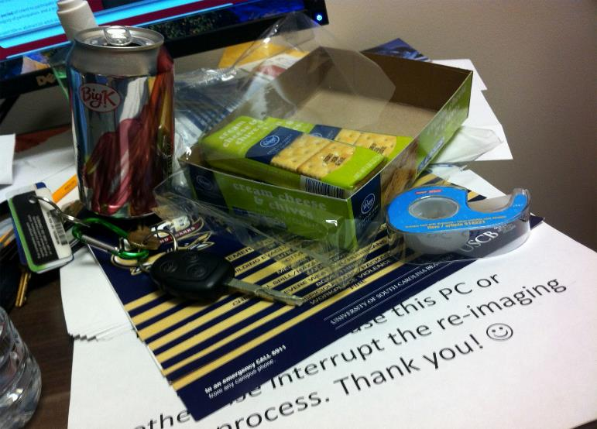
The challenge: The USCB Emergency Quick Reference Guide was available only in print form, was not easily portable, and may not be readily available when needed
“Now where did I leave that thing?”

Slide 14
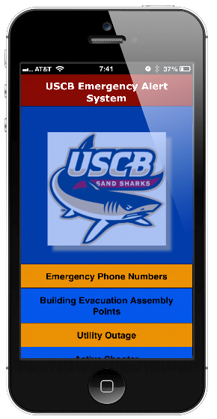
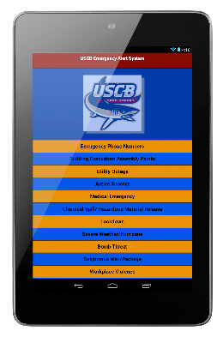
Our proposed solution: Design and develop an electronic version of the USCB Emergency Quick Reference Guide accessible to mobile phone and tablet users

Slide 15
Our proposed solution: Design and develop an electronic version of the USCB Emergency Quick Reference Guide accessible to mobile phone and tablet users

Slide 16
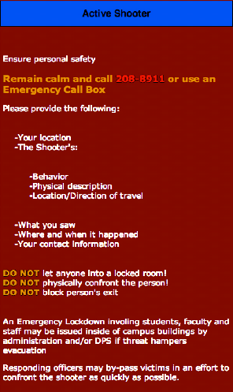
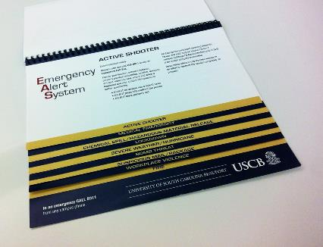
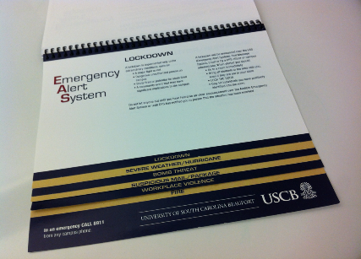
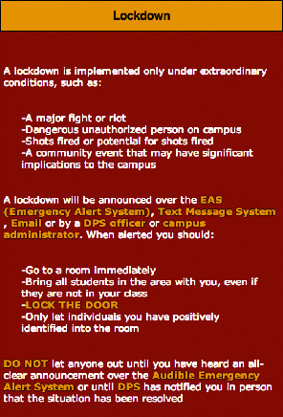
“Accordion”-style user interface
Bill Glesias, USCB Computational Science graduate, interned with BoomTown ROI, with Fidelity Investments

Slide 17
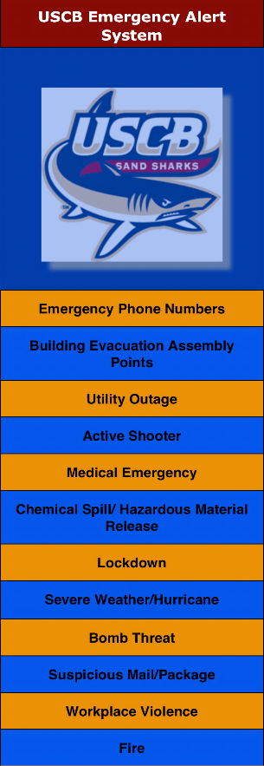
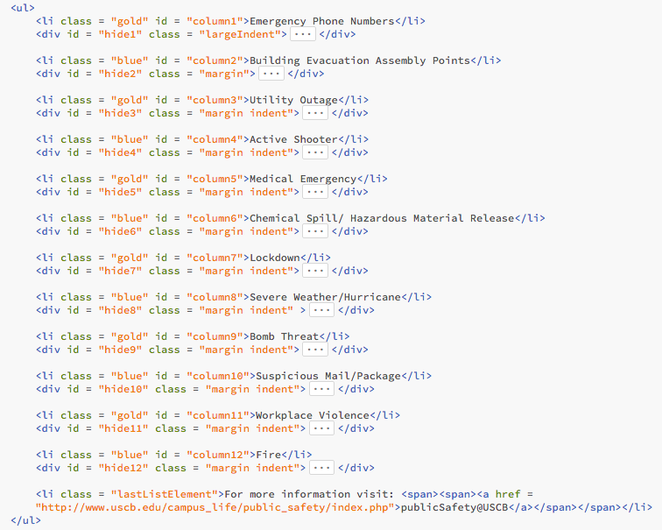
Building the “accordion” view: HTML

Slide 18
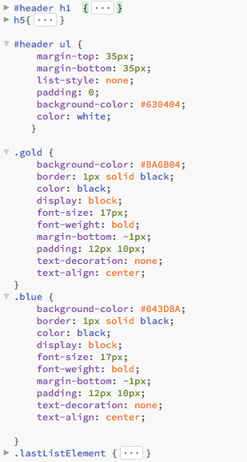
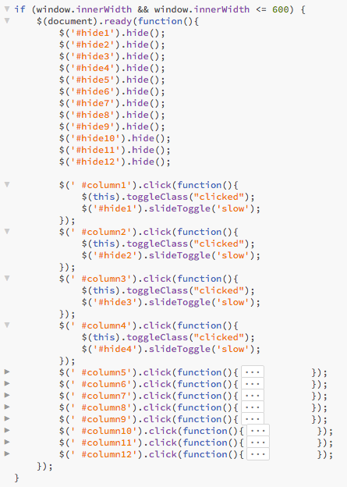
Building the “accordion” view: CSS & JavaScript

Slide 19
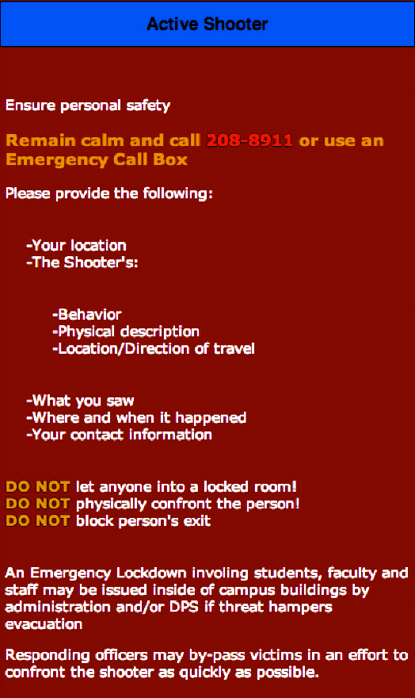
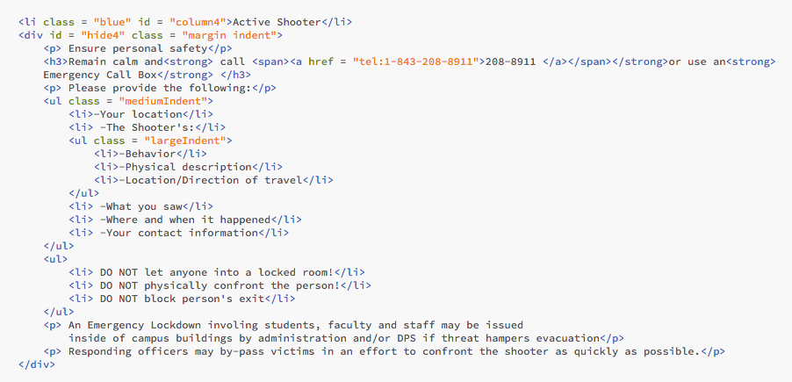
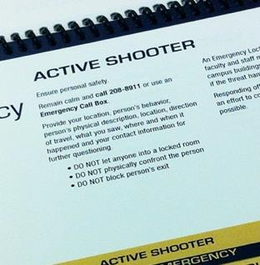
Building the Active Shooter section

Slide 20
After some CSS tweaking of the color scheme and additions to the user interface…
Erin Cline, USCB Studio Art graduate, now a freelance graphic designer, helped provide some design inspiration for the UI and “branding” of the app
…and, of course, an icon:

Slide 21
After testing for functionality in a standard web browser, we used PhoneGap to “package” the HTML, CSS, and JavaScript code into separate, “native-like” mobile apps for distribution
Disclaimer: It’s not a 100% “drop-in” solution—but it’s pretty close!

Slide 22
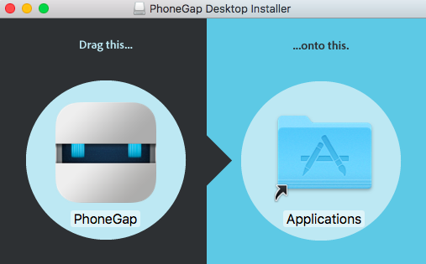
Getting started with PhoneGap, part 1: Install the desktop app

Slide 23
Getting started with PhoneGap, part 2: Install the mobile app on your phone or tablet
Go to your phone’s app store and search for PhoneGap Developer

Slide 24
Getting started with PhoneGap, part 3: Create your new PhoneGap app

Slide 25
Getting started with PhoneGap, part 4: Preview on device using PhoneGap mobile app

Slide 26
The “Hello World” example is nice and everything, but how about an actual app?

Slide 27
Let’s say you happen to have the source code for the USCB Safety “web app”…
On your laptop, open a web browser and go to:
http://sabal.uscb.edu/USCBsafety.zip

Slide 28
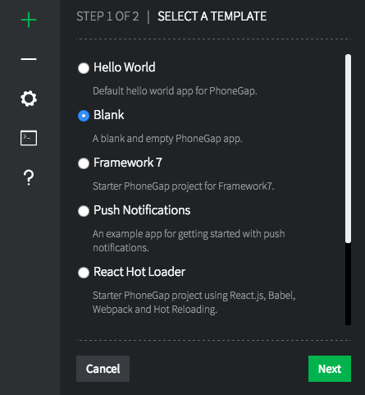
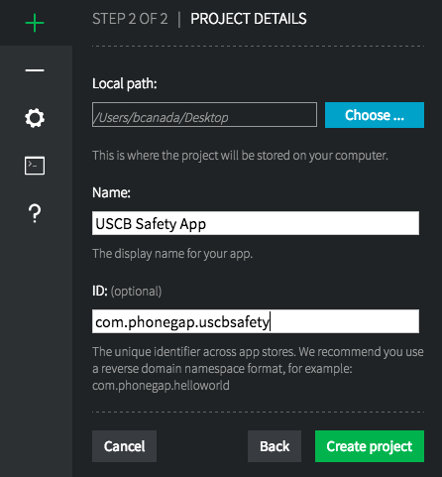
Use PhoneGap to create a new blank app…

Slide 29
Copy your mobile web documents into the www folder of your new PhoneGap project

Slide 30
Copy your mobile web documents into the www folder of your new PhoneGap project

Slide 31
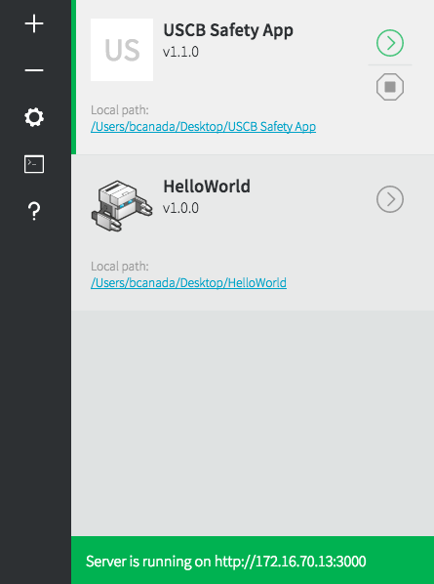
Now, try re-launching the PhoneGap developer mobile app and connect to the server to run your new app!
NOTE: These addresses must match or else the app won’t launch!

Slide 32
Strictly speaking, to get all the links to work correctly in PhoneGap, we’d have to make some additional changes:
Replace config.xml in your new project with config.xml from the HelloWorld app (and modify accordingly)
Copy the js folder from the HelloWorld project into the www folder of your new project
In index.html of your new project:
Copy all <meta> elements from www/index.html of HelloWorld into the <head> section of your new project
Modify all hyperlinks (<a> elements) to include an onclick attribute with value "window.open('placeholder-hyperlink', '_system');"
Add these lines of code to the end of the <body> section, just before the closing </body> tag: <script type="text/javascript" src="cordova.js"></script> <script type="text/javascript" src="js/index.js"></script> <script type="text/javascript"> app.initialize(); </script>

Slide 33
Next steps (on your own!): try packaging your mobile app in the cloud with PhoneGap Build https://build.phonegap.com/

Slide 34
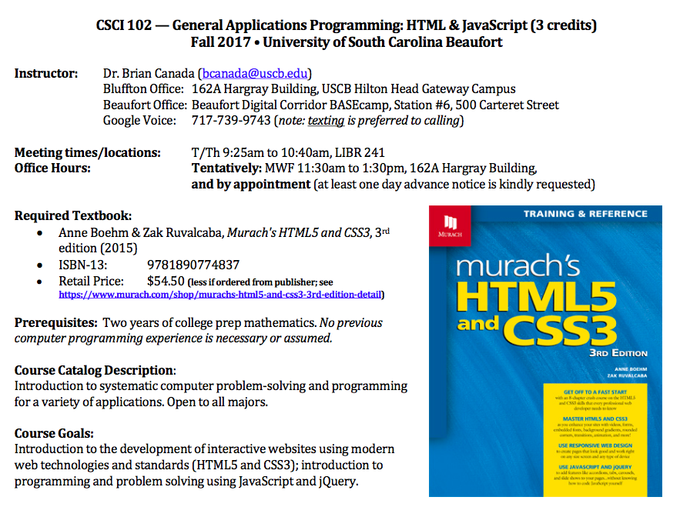
Want to learn more about front-end web development? Take my course at USCB (CSCI B102), offered every fall semester! (Or sign up for CodeCamp!!!)

